Slide 1

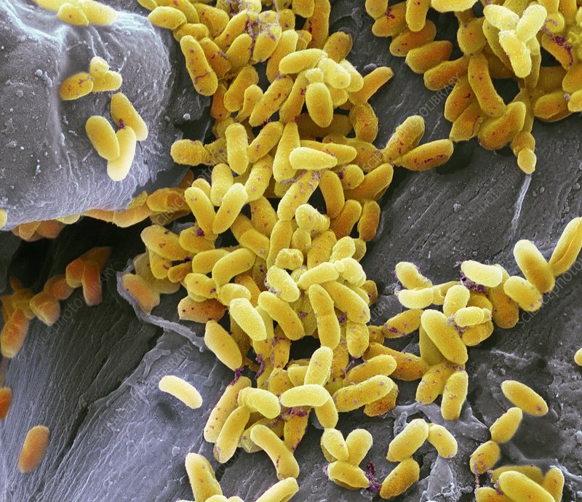
Progress of Research on Microbes for Nitrogen Removal
Reporter: Sahr Emmanuel (伊曼沙)
M202161014
Date: October 26, 2021

Slide 2
CONTENTS
Background and Signification
Types of Nitrogen Removal Microbes
Nitrification Microbes
Newly identified complete ammonia oxidizers (Comammox)
Denitrification Microbes
Anammox Microbes

Slide 3
Background and Signification
Groundwater and surface waters are contaminated by nitrogen via numerous routes. Nitrogen exists in different oxidation states which makes the process of its removal from water complex and challenging. Adsorption or co-precipitation treatment is most often not feasible due to the stability and high solubility of nitrate, resulting in high energy and cost for treatment of nitrate-contaminated water. However, microbes have proven to be effective agent in transforming or removing nitrogen from wastewater. Biological approaches are known to effectively remove nitrogen compounds in wastewater. The activated sludge process, as the most common biological wastewater treatment method, was developed to enhance the effectiveness of nutrient removal.

Slide 4
Types of Nitrogen Removal Microbes in Water
Nitrifying Microbes
Denitrifying Microbes
Anammox Microbes
Microbes

Slide 5
Nitrification
Nitrification refers to the process of biological conversion of ammonium to nitrate. This process uses Nitrosomonas bacteria to convert ammonium and ammonia into nitrite in two steps. Eventually, the process of nitrite conversion to nitrate is done by the use of Nitrobacter.

Slide 6
Nitrifying Microbes
Known as the nitrifying bacteria strictly autotrophic.
Chemolitrophically at the expense of reduced inorganic nitrogen compounds (oxidation of ammonia to nitrates)
There are currently four major genera accepted in the family. The genus Nitrobacter, Nitrospina, Nitrococcus and Nitrosipra.
The GC content of the DNA is 50-62 mol%.
Ammonia-oxidizing bacteria-the nitrosifyers (Nitrosification)
Nitrate-oxidizing bacteria-the nitrifying (Nitrification)
Higher plants cannot utilize nitrites as their source of nitrogen.
Nitrate is the most useful form of nitrogen in agricultural purposes. ○ Nitrobacter oxidizes nitrite to nitrates.

Slide 7

These are Gram-negative bacteria.
Non-sporing non-acid fast rods, which may be pleomorphic or coccoid (Nitrobacter), some are slender rods (Nitrospina), cocci (Nitrococcus) or spiral to comma-shaped (Nitrosipra)
They may be motile.
They are characterised by their ability to use nitrite as the only engergy. They are facultative or obligate lithoautotrophs.
They fix CO₂ autotrophically through the Calvin cycle but are not photosynthetic.
They grow best in the dark around 28°C at pH between 7. 6 - 7. 8 and many grow mixotrophically than lithoautotrophically.
They have all the enzymes of the tricarboxylic acid cycle.

Slide 8
Properties and Characteristics of Ammonia Oxidizing Bacteria
Ammonium Oxidizing Bacteria
Characteristics | Genus | Phylogenetic Group | DNA (mol% GC) | Habitat
Gram-negative short to long rods,motile (polar flagellajor nonmotile):peripheral membran systems | Nitrosomonas | Beta | 45-53 | Sewage, soil, freshwater, marine
Large cocci, motile, vesicular or peripheral membranes | Nitrosococcus | Gamma | 49-50 | Freshwater,marine
Spirals, motile(pentrnchous flagella);no obious membrane system | Nitrosospira | Beta | 54 | Soil
Pleomorphic.lobular,compartmented cells;motile(pentrichous flagella | Nitrosolobus | Beta | 54 | Soil

Slide 9
Properties and Characteristics of Nitrite Oxidizing Bacteria
Nitrite Oxidizing Bacteria
Characteristics | Genus | Phylogenetic Group | DNA (mol% GC) | Habitat
Short rods, reproduce by budding, occasionally motile (single subterminal flagella) or non-motile; mermbrane system arranged as a polar cap | Nitrobacter | Alpha | 59-62 | Sewage, soil, freshwater, marine
Long, slender rods,nonmotile,no obvious membrane system | Nitrospina | Delta | 58 | Marine
Large Cocci, motile (one or tio subterminal fiagellum) membrane system randomly arranged in tubes | Nitrococcus | Gamma | 61 | Marine
Helical to vibroid-shaped cells: nonmotile;no internal membranes | Nitrospira | Nitrospirae | 50 | Soil, marine

Slide 10










Purification theory of Nitrifying Bacterial
Step 1:- autotrophic Ammonia-oxidizing bacteria (AOB) oxidize ammonium (NH₄⁺) to nitrite (NO₂) via hydroxylamine (NH₂OH) in the first phase of nitrification (reactions 1 and 2, below).
Ammonium (NH⁺₄)
Nitrosomonas
Ammonia change to nitrites(NO₂⁻)
Nitrobacter
Nitrifying bacteria convert nitrites to nitrates (NO₃⁻)
(1)
(2)
(3)
Both processes are catalyzed by membrane-bound ammonia monooxygenase (AMO) and hydroxylamine oxidoreductase (HAO).
Step 2:- nitrite-oxidizing bacteria (NOB) use membrane-bound nitrite oxidoreductase (NOR) to convert nitrite to nitrate (NO₃⁻) (reaction 3).
Plant absorb nitrates and grow

Slide 11
Progress and Application study on Nitrifying Microbes
Nitrifying Bacterial are use to naturally convert ammonia to nitrate in the environment
They are also use as Biological catalyst or agent in removing nutrients from waste water.
In Singapore and Austria, they are used in activated sludge process for deammonification.

Slide 12
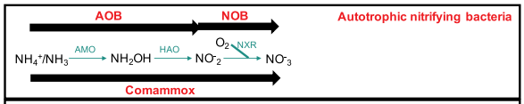
Newly discovered Microbes
Nitrification, or the conversion of ammonia to nitrate via nitrite, has long been thought to be a two-step process mediated by two different types of bacteria. The discovery of full nitrifying single bacterium (Comammox: Complete ammonia oxidation bacteria) not only shattered the nitrification labor division paradigm, but it also raised basic concerns about the distribution, diversity, and ecological relevance of complete nitrifiers in comparison to classical nitrifying microbes.
Bacteria of the genus
Nitrospira sp. which we knew as nitrating bacteria

Slide 13
What is Denitrification
Denitrification is converting Nitrate (N0₃⁻) to atmospheric Nitrogen (N₂) replenishing the atmosphere.
Many microbes involving.( mostly heterotrophic and autotrophic bacteria species)
Denitrifying microbes require very low O₂ concentration of less than 10% .

Slide 14
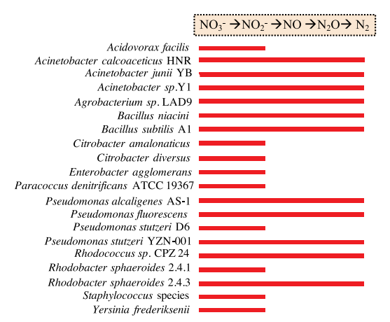
Diversity of denitrifying bacteria
There is a great diversity in biological traits. Denitrifying bacteria have been identified in over 50 genera with over 125 different species and are estimated to represent 10-15%of bacteria population in water, soil and sediment.Denitrifying include for example several species of:

Slide 15
The strain is spherical or short rodlike, arranged in pairs or in columns,
The optimum growth temperature is 37C, and it can grow in the range of 15–42C
The optimum pH range of 6.5–10.5. It can still reduce nitrate in the water dissolved oxygen saturation of 90%.
The majority of aerobic denitrifying bacteria has a good tolerance to oxygen and can maintain a high denitrification rate under aerobic conditions.
Heterotrophic denitrification uses organic carbon resources such as acetate, acetic acid, methanol and ethanol as its energy resources.
In autotrophic denitrification Microbes use hydrogen, iron, and sulfur as energy resources

Slide 16
Properties and Characteristics of some Denitrification Bacteria
Ammonium Oxidizing Bacteria
Characteristics | Genus | Phylogenetic Group | DNA (mol% GC) | Habitat
Gram-negative, rod-shaped, and polar-flagellated bacteria with some sporulating species: peripheral membran systems | Pseudomonas | Beta | 59.5-6.8 | Soil, freshwater, Vegetation
Gram-negative bacilli, non-motile, twitching motility, outer membrane vesicles | Acinetobacter | Gamma | 40.44 | Soil, water
Gram-negative bacteria, motile( flagella);no obious membrane system | Comamonas | Beta | 65-75 | Soil, mud an water(polluted)
Pleomorphic.lobular,compartmented cells;motile(pentrichous flagella | Achromobacter | Beta | 65 | Soil, water

Slide 17
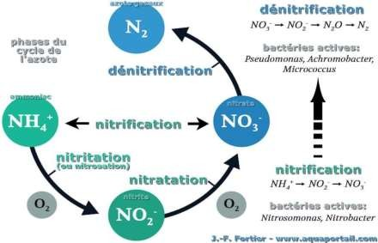











Process of Denitrification
After Nitrification process
Nitrate (N0₃⁻ )
Nitrite (NO₂⁻ )
Nitric Oxide ( NO)
Nitrous oxide (N₂O )
Nitrogen (N₂)

Slide 18
Purification theory of Denitrifying Bacterial
Nitrate Reductase (NAR)
Nitrate reductase catalyzes the first step of the denitrification process, the process of nitrate reduction to nitrite. There are two different types of nitrate reductase, i.e., membranous nitrate reductase (NAR) and periplasmic nitrate reductase (NAP) :
Nitrite Reductase (NIR)
Nitrite reductase is the key enzyme of the denitrification pathway. The reduction reaction of nitrite to NO is a marked reaction between denitrification and other nitrate metabolism:
Nitric Oxide Reductase (NOR)
NO reductase plays a key role in the process of denitrification it participates in the aerobic denitrification process. NO reductase has a high affinity for NO; it can be limited to the concentration of electrons for NO reduction, thereby reducing the concentration of NO maintained at a very low level and to avoid the body itself caused by toxic effects:
N₂O Reductase (N₂OR)
The final step of the denitrification process N₂O reductase catalysis is the reduction of N₂O to N₂.

Slide 19
Progress and Application study on Denitrifying Microbes
Denitrifying Microbes are very essential for biological treatment of wastewater. They are applied to bio-reactors with a combination of different technologies. Some recent technologies that use denitrifying microbes includes the following:
Simultaneous nitrification and denitrification (SND): - SND particularly for treating wastewaters with low C/N ratio (< 5) is the occurrence of both nitrification and denitrification simultaneously in the same reactor and saving cost for anoxic tank. the biological mechanism of SND is based on the activity of heterotrophic nitrifiers and aerobic denitrifiers with the capacity of denitrification even at oxygen-saturated condition
Shortcut Nitrification and Denitrification:-Shortcut nitrification and denitrification. Shortcut nitrificationand denitrification also called as partial nitrification-denitrification, is feasible technology for treatment of wastewaters with high ammonium concentrations or low C/N ratios. In this case, nitrite is produced by nitrification as an intermediate product instead of nitrate and subsequently reduced to N2 by nitrite denitrification

Slide 20
Anaerobic Ammonium Oxidation (ANAMMOX)
Anammox bacteria oxidize ammonium using nitrite as the electron acceptor. Nitrite can be obtained from nitritation (oxidizing ammonium to nitrite) and partial denitrification (reducing nitrate to nitrite).
This unique method of oxidation in wastewater treatment has obvious advantages, for example oxygen demand is reduced by 60%, organic carbon demand is reduced by 100% and the sludge yield is reduced by 90%. Nearly energy-neutral or even energy-positive treatment schemes are possible, when anammox technology is included. Therefore, it has become a hot spot of water treatment research.

Slide 21
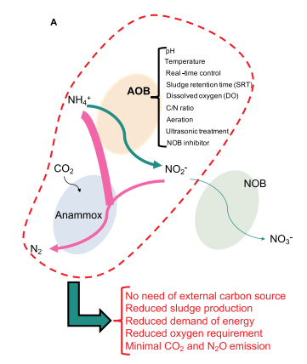
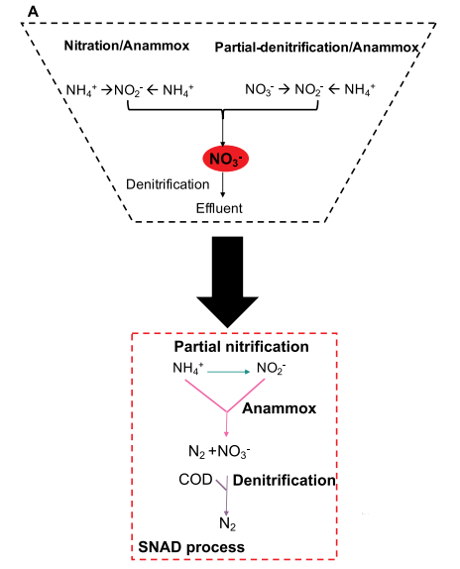
(A) Strategies for partial nitritation and anammox by ammonium oxidizing bacteria (AOB) and suppression of nitrite oxidizing bacteria (NOB). (B) Anammox process with the need of post denitrification treatment leading SNAD (simultaneous nitrification, anammox and denitrification) process (A). In
SNAD process, ammonia is partially oxidized to form nitrite, and then anammox and denitrification together remove ammonia and nitrate, respectively.

Slide 22
Diversity and habitat of anammox bacteria
Six genera of anammox bacteria within the phylum Planctomycetes have been confirmed, including Candidatus Kuenenia, Ca.Brocadia, Ca.Anammoxoglobus, Ca.Anammoximicrobium, Ca.Jettenia, and Ca.Scalindua
Add Title
Among these, the first five types are commonly found in wastewater treatment and freshwater systems, while the last one is commonly found in saline environments such as seawater and sediments.
Physiology and environmental factors affect the distribution of types of anammox bacteria significantly.
under low nitrogen loading rate (NLR) conditions, Ca.Brocadia anammoxidans, Ca.Jettenia, Ca.Anammoxoglobus, and Ca.Kuenenia are dominant,
while underhigh NLR conditions, Ca.Brocadia sinica and Ca.Kueneniastuttgartiensis dominate.
Add Title
Add Text Add Text Add Text Add Text Add Text Add Text Add Text
Add Title

Slide 23
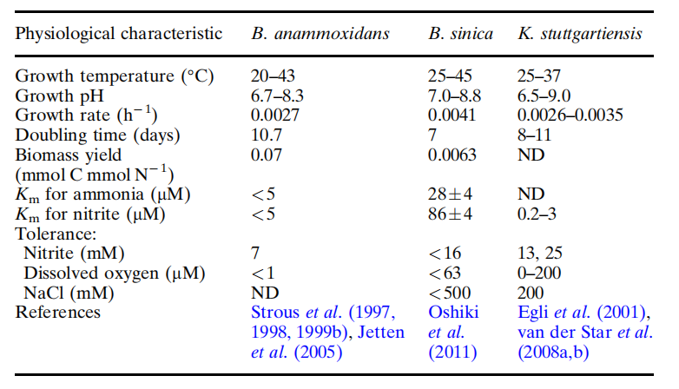
Physiological characteristics of Brocadia anammoxidans, Brocadia sinica,
and Kuenenia stuttgartiensis.

Slide 24
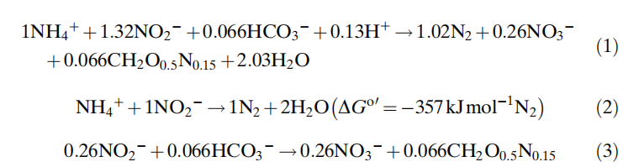
Purification theory of Anammox Bacterial
Anammox bacteria grow on the conversion of ammonium and nitrite with CO2/bicarbonate as the sole carbon source. Operating under steady-state conditions in lab-scale bioreactors, the compounds are metabolized according to this overall equation.
The overall reaction is the net sum of two partial reactions: the energy generating process, viz., the oxidation of ammonium coupled to nitrite reduction to make dinitrogen gas (Eq. 2), and bicarbonate fixation into cell biomass (CH₂O_{0.5}N0_{.15}) (Eq. 3). One may note that both nitrogen atoms derive from two different substrates, ammonium and nitrite. Using 15N-labeled substrates (¹⁵NH₄⁺ or ¹⁵NO₂⁻), ²⁹N₂ is the specific end product of the anammox reaction.

Slide 25
Progress and Application study on Anammox Microbes
Anammox microbes can be combined with other microbes and be applied to biological reactors for wastewater treatment. Anammox microbes can be applied to the following biological nitrogen removal technology:
SNAD process (simultaneous partial nitrification, anammox, and denitrification):- It conducts three chemical reactions by three bacterial communities aerobic AOB, anammox, and denitrifying bacteria in a single reactor under oxygen limiting conditions.
2. SHARON (single reactor high activity ammonia removal over nitrite) anammox (two-reactor system)
3. CANON (completely autotrophic nitrogen removal over nitrite in single reactor system)

Slide 26
Thank You
Reporter: Sahr Emmanuel (伊曼沙)
M202161014
Date: October 26, 2021

